Slide 1
Semi project of analyzing data of purchased online products.
Prepared by\
Eng: Mourad
Eng: Eslam
Eng: Omar

Slide 2

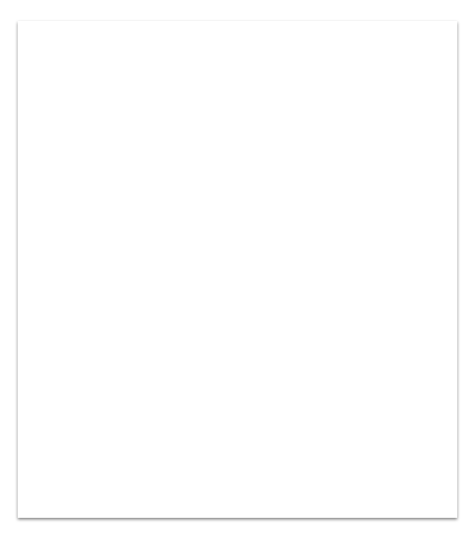
Introduction:
The Data that we deal with, Is about products and relations with times of purchased and prices.
And also between
cities and the most purchased products.
Tip:
We use visualization algorithms to see the relations and get benefit from all values.
.

Slide 3
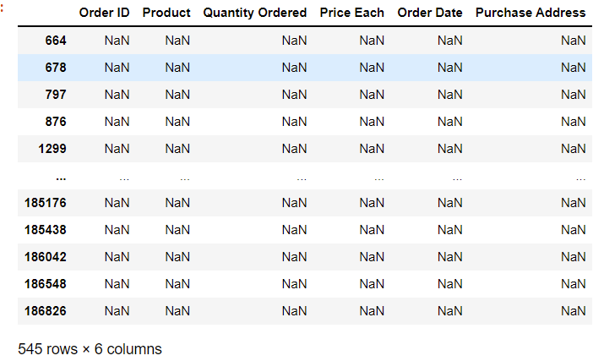
The data Frame:
The data frame was consisting of 186849 rows and 6 column featured.
We firstly filtered the input data frame from the errors and missing values and duplicated ID and we removed nans to deal with correctly information.
Filter 1,
Nans data

Slide 4
1. Types of filters that we used:
Filter 1:
Removed nans from data and it was about 545 nans which was .3%.
Of all the data
Filter 2: Filter to drop all the strings in order ID and all of them are named by "Order ID” and it was 355 errors which about .2% of all the data.
Filter 3: Filter to drop all the dublicated "Order ID" from the [Order ID] and it was about 7513 values which was 4.2% of all the data.

Slide 5
Finally:
Now we have (178437) rows which remain after filtering all missing and duplicated values.
Visualization:
We did a visualization to analyse the most
purchased products and the most Quantity Ordered.
Also we made visualization to find out the most city in which products were purchased in different months.
We also used box plot to find out the "min" , "max" , "median" , and the outliers points.

Slide 6

THANK YOU
AI-EAGLES

